Slide 1
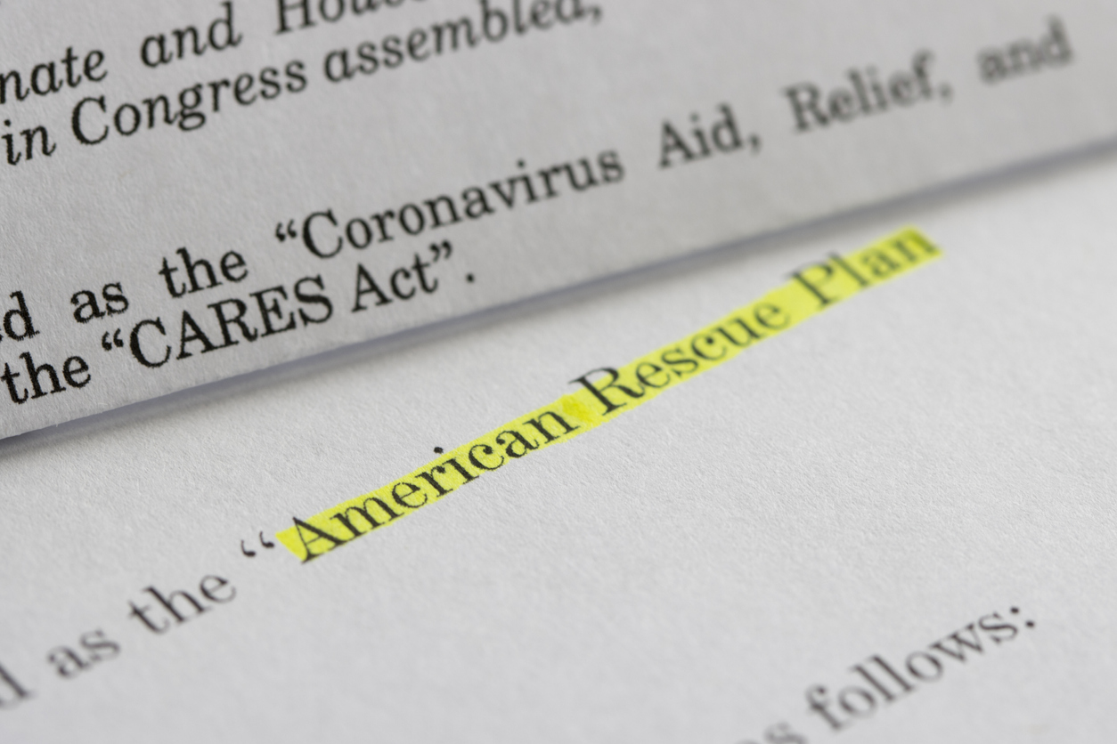
Coronavirus State and Local Fiscal Recovery Fund Update
Washoe County Senior Advisory Board
January 5, 2022

Slide 2
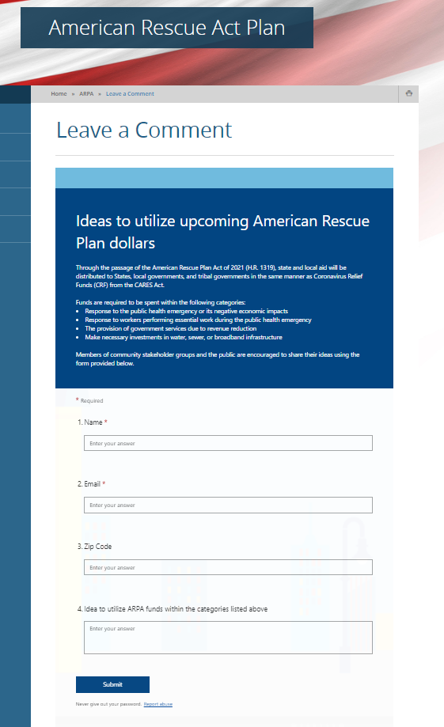
Washoe Public Comment Portal
Comment/Project Idea Input:
Water and Sewer
Roads (not ARPA eligible)
Affordable Housing/Homelessness
Parks
Broadband
Input collected through November 30, 2021

Slide 3
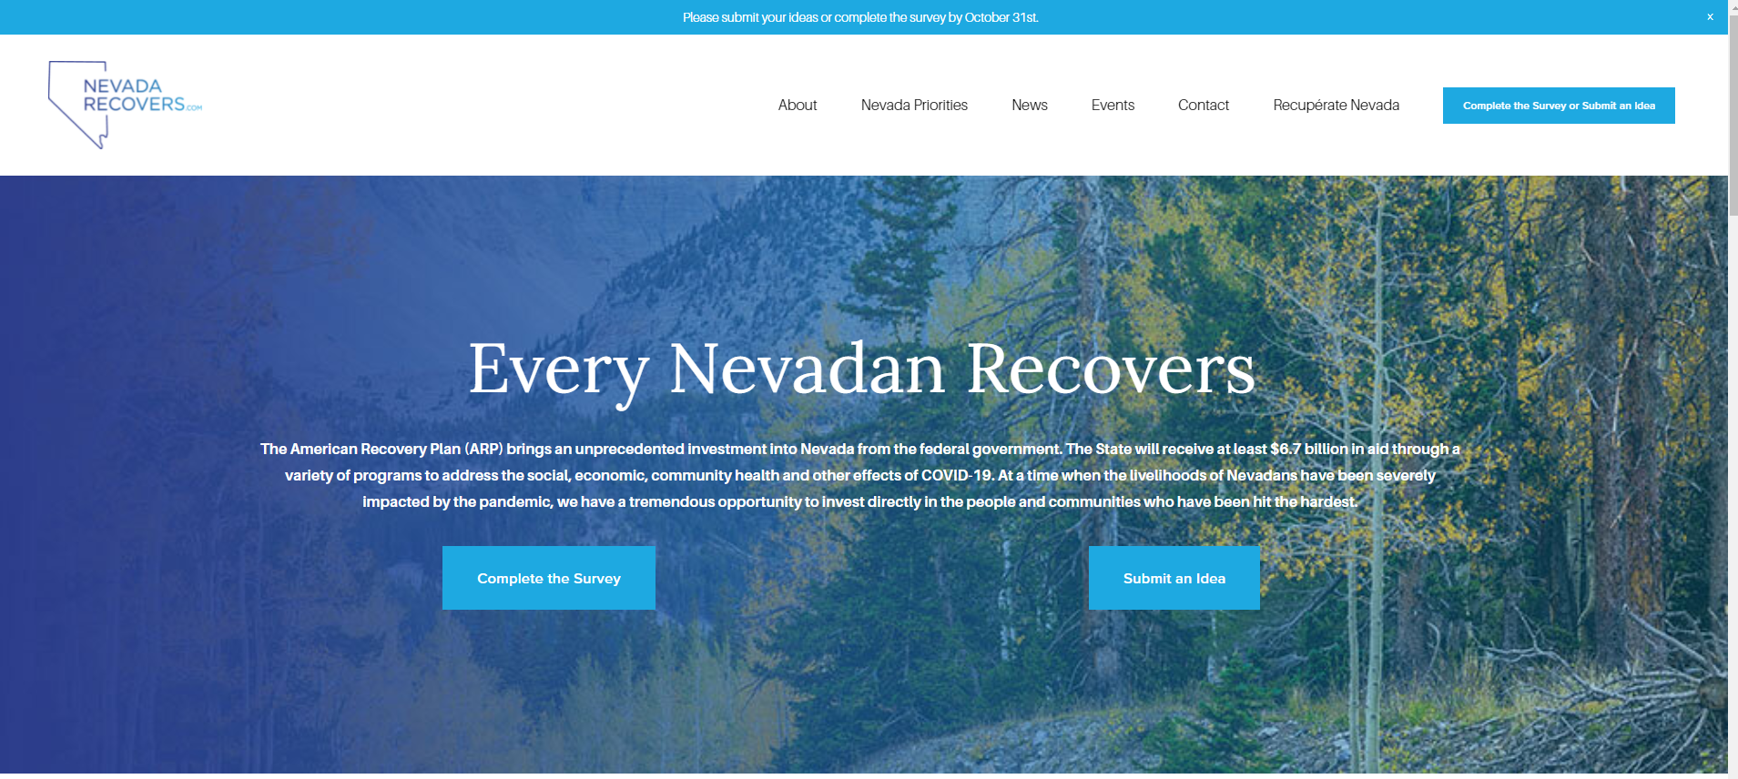
Projects Submitted State ARPA Funding for Northern Nevada
Transitional and Affordable Housing
Sewer and Wastewater Infrastructure
Broadband
Health District
Electric Vehicle Fleet
Repair & Replace High-Emitting Vehicles
TB Clinic
Health District Satellite Office
State ARPA Project Submission Deadline 10/31/2021
Notes:
State of Nevada – Recovery Grants to Non-profits over 337 applicants requested $445M The state will award $30M.
Also Infrastructure Investment Jobs Act

Slide 4
Guiding Principles
One-time projects and infrastructure.
​
Not used to escalate overhead expenses. ​
Collaborate with regional partners where possible.​
Projects that meet the following outcomes are ideal:​
Transformational, innovative investments​
Align with County Strategic Plan ​
Achieve equitable outcomes​ & serve underserved populations​
Solve community issues by attacking root causes (childcare, mental health, affordable housing)​

Slide 5
WASHOE ARPA Projects
Current Board Approved Projects Funded $40,201,764 (44%)
Total Award $91,587,038

Slide 6
Urgent Projects
Housing & Homelessness Services
Washoe County Safe Camp Capital - $4,500,000 (BCC approved 7-20-21)
Washoe County Cares Campus Capital - $21,468,706 (includes $4M BCC approved 7-20-21)
Cares Campus – Facilities Operations FY22 - $1,861,112
Homeless Management Information System – Case Management - $250,000
Clerk Staffing for CHAB and Clerk’s Office Administrative - $58,895
Human Services Agency
WellCare Living Supports Pilot Project - $661,500 (includes $612k BCC approved 8-17-21)
Kids Kottage Emergency Beds FY22 - $800,000
Critical CPS Personnel - $527,133
Human Services Agency Vehicles (9) - $283,500
Our Place – Enhancements - $450,000
Our Place – Community Garden Fence - $130,000

Slide 7
Urgent Projects
Public Defender, District Attorney, and Courts
Public Defender’s Office – Court Case Backlog Personnel & Workstations - $1,316,195
District Attorney’s Office – Court Case Backlog Personnel & Workstations - $2,423,414
Sparks Socially Distanced Courtroom - $380,900
Sparks Justice Court – JAVS Audio Visual Upgrade - $138,638
Reno Justice Court – Courtroom A Remodel - $500,000
Self-Help Center - $90,675
District Court – Courtrooms Audio Visual Upgrade - $1,285,000
Sheriff’s Office
Deputy Sheriff Positions - $1,956,096
Detention Facility UVC Sanitation - $140,000
Medical Examiner
Contract Staff, Pooled Positions, Overtime, PPE & Supplies - $190,000
Health District
Mobile Outreach Vehicle/Command Post - $490,000
Improvements to Public Health Technology Infrastructure - $300,000

Slide 8
TIMELINE
January 5, 2022
Second half/allocation to be received (May 2022) $45.7M
August – Nov 2021
Jan. 2022→ 2027
Assess Community Needs
Identify Priority Projects
Implementation of Projects
&
Reporting Outcomes
Immediate priorities are supporting launch and implementation of the 23 urgent projects, development of Washoe County’s community-based grant making process, and to prepare/submit the 1st quarterly project report due January 31st.
https://www.washoecounty.gov/ARPA/
Reminder: funds must be allocated by December 2024 and expended by December 2026
Assess pressing
community needs
Involve local
solution providers
Begin allocation
of funds
Report progress
to community
Notes:
Subscribe on our webpage for updates.

Slide 9
Infrastructure Investment Jobs Act
The breakdown of Nevada’s minimum expected funding contained in the Investing Infrastructure and Jobs Act is as follows:
$2.5 billion for federal-aid highway apportioned programs
$459 million for public transportation
$403 million for water infrastructure
$293 million for airport improvements
$225 million for bridge replacement and repairs
$100 million for broadband infrastructure
$38 million for the expansion of electric vehicle charging stations
$12 million in cybersecurity infrastructure
$8.6 million for wildfire prevention

Slide 10
Questions?

